Slide 1
mezzònomy
April 2017
Notes:
How Hypertext, powered by Blockchain, can provide the next World-Wide Electronic Editing Ecosystem.

Slide 2
Mission statement
Bring the power of blockchain to every office
every process
every organization
by delivering a private blockchain with no entry barrier

Slide 3




The power of blockchain
Inviolable and secured log
of transactions
Sourced transactions
by design
No need of third parties
to contract
World currency without
world state

Slide 4
The pains of blockchain
Required expert blockchain programmers are third parties. An’t they?
If anyone knowns what I do
how can I make anticipations?
Am I always bound to a
crypto-currency?
How can I develop my own Smart Contracts ?

Slide 5
The Blockchain Ecosystem Today
Many vertical start-ups try to develop
specific applications based on crypto-currencies
Supply chain
Fintech
E-Health
StartUp
A
StartUp
B
...
StartUp
Y
StartUp
Z
Crypto-currencies
(Bitcoin, Ethereum,...)

Slide 6
What we want to achieve
Direct implementation of blockchain applications by business actors
Supply chain
E-Health
Co-engineering
Fintech
(bitcoin is cool)
...
mezzonomy’s blockchain machines
→ beyond crypto-currencies → lower entry barrier

Slide 7
Target markets – B2B only
Supply chain
E-Health
Co-engineering
Audit
2 200 M€
est.
1 100
M€
est.
950
M€
est.
1 050
M€
mezzònomy platform
addresses all markets

Slide 8
Application examples: strong on operation efficiencies
addressed markets
Invoice
reconciliation
Confirmation
letters
Smart-contract
lifecycle
management
mezzònomy platform
addresses all markets

Slide 9



Five differentiators
Easy
Cooperative
Protected
Administrated
Private BC

Slide 10
Easy integration of blockchain power
in any web service
Recycling of existing digital assets (HTML/XML, XSL/CSS)
Blockchain any process (Lite, Regular, Full)

Slide 11
Cooperative process everywhere
Negotiation and consensus at the heart of the system,
the look & feel of tomorrow systems.

Slide 12
EP2011/071770
US 20130304678 A1
Share your data and protect its value
The value of any content is the story leading to it
Sharing any content without its story keeps the value safe

Slide 13
Adminstrated blockchain machine
embedded invoice mechanisms
no need of crypto-currency

Slide 14
Private blockchain
Every organization may implement its private blockchain
And at one point in time, control how to make it public.

Slide 15
Five differentiators
Easy
Cooperative
Protected
Administrated
Private BC

Slide 16
Product Line Roadmap
Deliver next generation of Office Applications
Full
Deliver smart contracts applications
includes administration and supervision of blockchain network
Regular
Deliver blockchain web services
With basic XSL resources
Recycling existing web services
Lite

Slide 17
Product Lines
Offering | Administration & supervision | Components | Development
Lite | Wizard | Quantified Entry monetary, scientific | N/A (GitHub)
Regular | Architect | Composing Cell spreadsheet and screen composer | Smart-Contract Composer
Full | – | Smart Paragraph Office automation | Application Forge
Each ledger is billed with respect to the offering level and the maximum extension of the network

Slide 18
Key factor of success: notoriety
who knows that we
Bring the blockchain power to every organisation
Door-to-door team: Incremental selling of POC, Ramp-Up and maintenance.
Hackaton task-force: Assert the mission statement by winning these sportive-like competitions.
Ecosystem community: super-fluid web site, video tutorials, interactive presence.
→ ignite viral spreading
→ world wide standard candidate

Slide 19
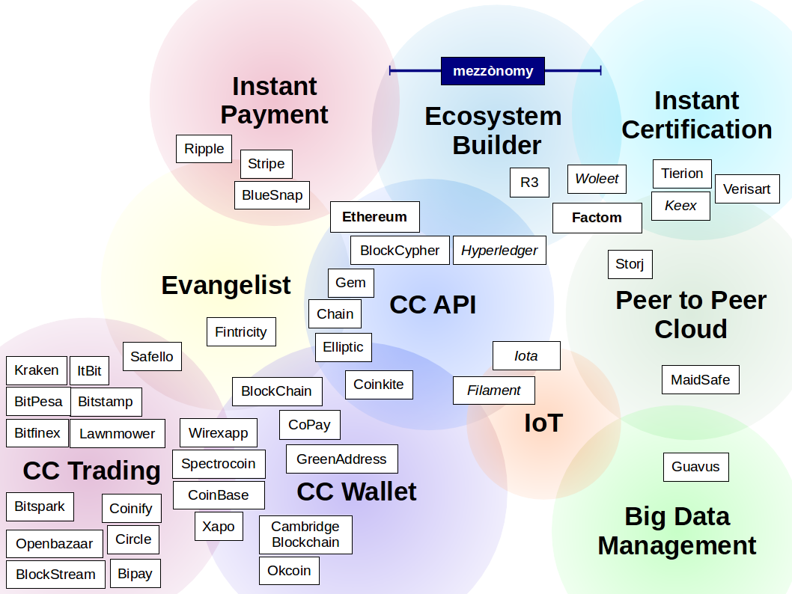
Blockchain investment map

Slide 20
Mezzonomy positioning
mezzònomy positioning is
to be an Ecosystem Builder,
with a distinctive economic model based on
  an embedded Payment System
  and dedicated to Content Certification

Slide 21
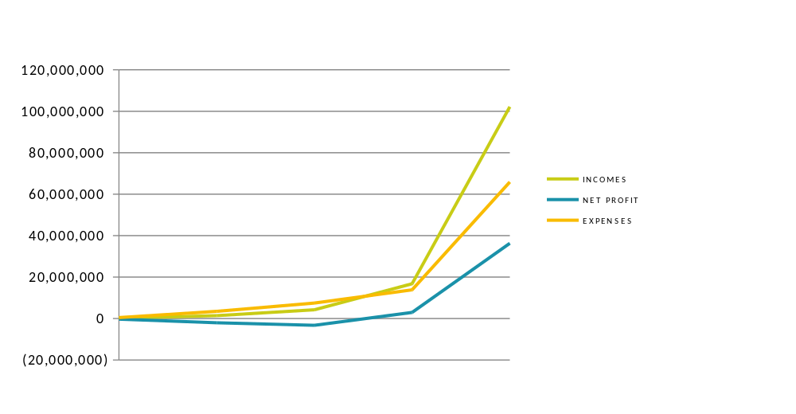
Give birth to a B2B unicorn in four years
=
Main developments
Regular
Full
2017
2019
2021
VC Investors (11M€)
B€

Slide 22
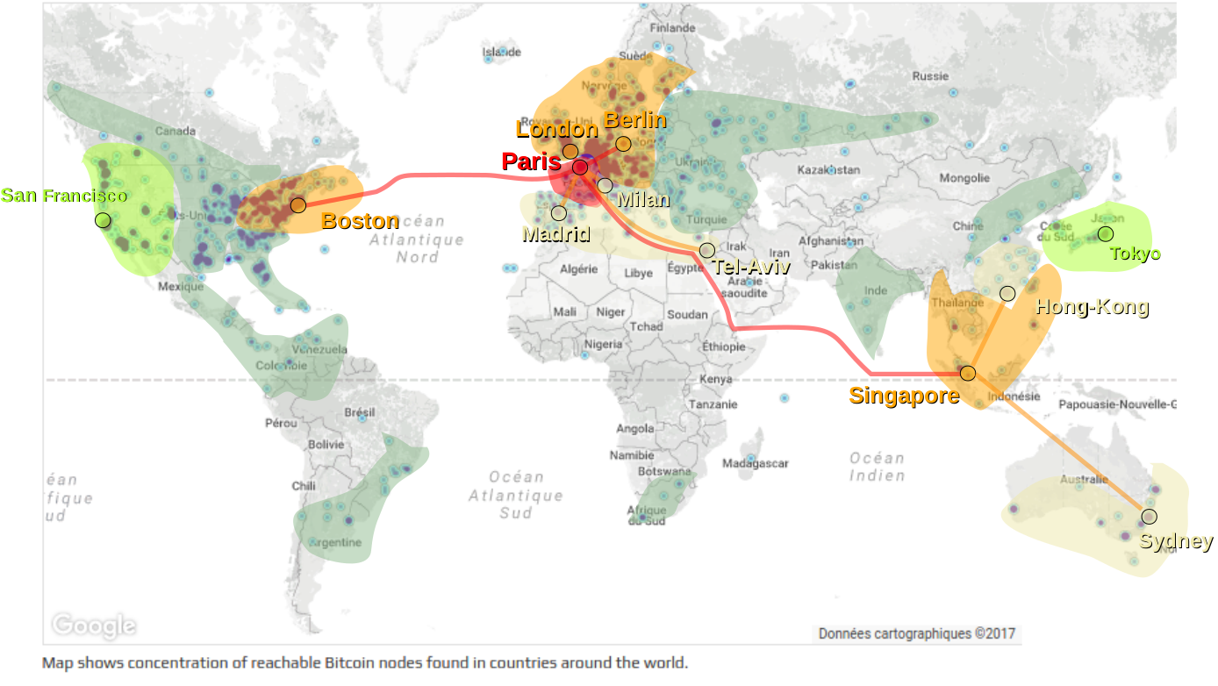
Global replication
2017
2018
2019
2020

Slide 23
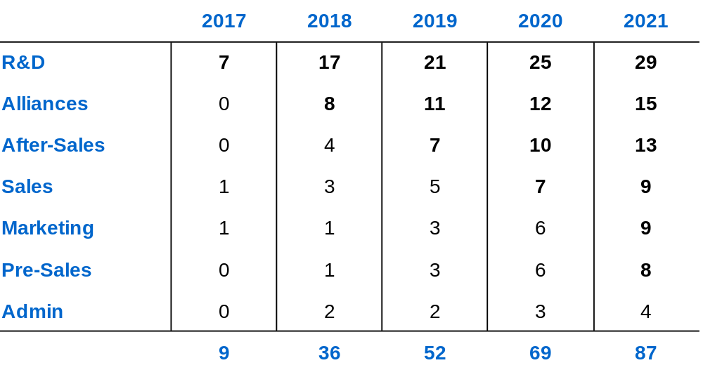
Head-count ramp-up

Slide 24
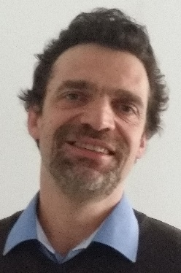
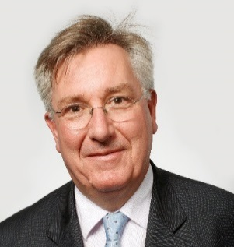
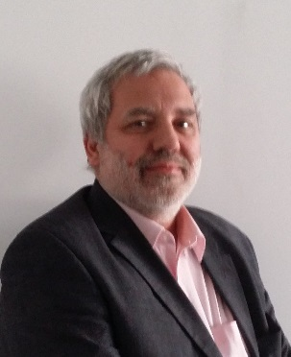
Inception team
Pierre Gradit
PhD Computer Science
Invention and vision of the Blockchain Hypertext
François Charpe
C-level experiences
Business developer & start-up founder
International exposure
Michel Rascol
Serial Start-upper
Supply-Chain and
Health Expert

